Slide 1
Job Club: Self Advocacy
9/17/20

Slide 2
What are we looking forward to today?
What is self-advocacy?
How can I achieve it?
How does it relate to work?

Slide 3
Warm up question
If you were given a $500 gift card, what would you want/need to buy?

Slide 4
Self-Advocacy
the action of representing oneself or one's views or interests.
https://www.youtube.com/watch?v=74G_Zpz-7Bk

Slide 6
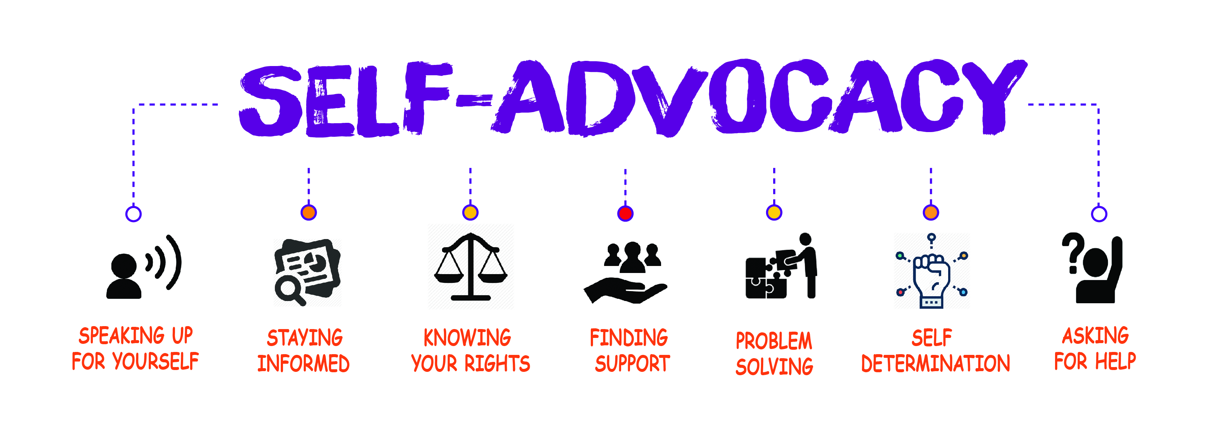

Slide 7
SPEAKING UP FOR YOURSELF
Don’t be afraid to show confidence
Stay positive
Treat yourself with respect

Slide 8
Use Your Resume
Skills & Abilities
Maintenance & Construction
Familiar with basic maintenance procedures including plumbing and electrical repairs, Tile replacement, painting and landscaping
Repair of Lamps, fans and other basic electrical equipment and motors for retail sale.
Custodial & Cleaning
Experience with general Custodial Procedures including washing windows, sweeping vacuuming, and shoveling snow
Experience with food service-related cleaning including washing dishes and general kitchen cleanup
Food Service and Customer Care
Experience baking muffins, making coffee and other food service tasks at a small canteen
Experience waiting on customers, using cash register and making change

Slide 9
Stay Informed
Know your rights and responsibilities
Pay attention to what’s happening around you
Keep up to date with rules and regulations
http://www.wboc.com/clip/15052489/a-look-at-employee-rights-during-covid-19

Slide 10
Finding support
Check in with your job coach
01
Ask questions
02
Discuss the issue with your manager
03

Slide 11
Humble brag share
Go find something in your house that you’re proud of to share with the group. Be back in 3 minutes.

Slide 12
Problem Solving
Use your knowledge and experience
Communicate – Speak appropriately and listen actively
Be creative
https://www.youtube.com/watch?v=1iMthJ7n4lM

Slide 13
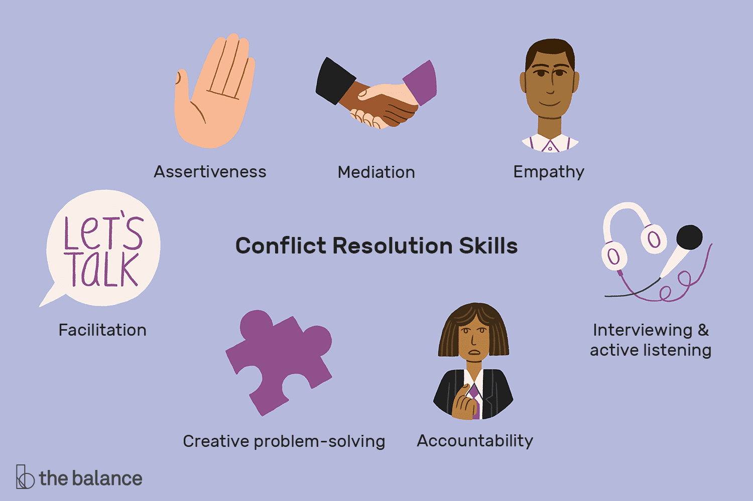

Slide 14
Back in the Game - interview question
Tell me about a time you solved a problem at work.

Slide 15
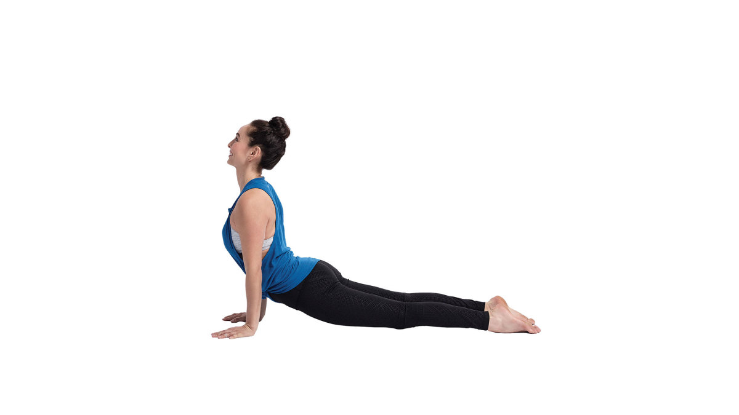
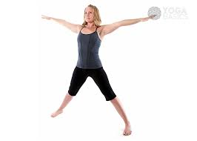
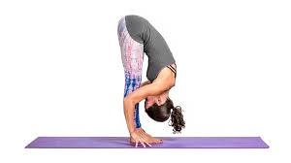
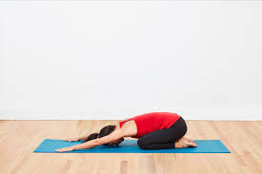
YOGA BREAK-
5 minutes

Slide 16
Active listening role play
Person 1: Please say to your partner the following sentence.
“I do not deserve to be made fun of and I want you to treat me with respect.”
Person 2: Explain to Person 1 what you heard them say.

Slide 17
Self Determination
Decide
Decide – Where do you want to go – SET A GOAL
Act
Act – Head down the right path – ACHIEVE THE GOAL
Believe
Believe – Have confidence – BELIEVE IN YOURSELF
https://www.youtube.com/watch?v=0g2yUQ2TSTE

Slide 18
Communication exercise
Scenario:
You have been working as a bagger in a grocery store. Sometimes you are responsible for bringing in the carts. You want to spend less time in the summer heat gathering shopping carts and are unhappy with this responsibility. How might you communicate this?
Decide
Act
Believe

Slide 19
Asking for Help
Be professional, yet direct
Stay open to suggestions
Listen to other perspectives

Slide 20
Links
Self-Advocacy Intro - https://www.youtube.com/watch?v=74G_Zpz-7Bk
Stay Informed Video - http://www.wboc.com/clip/15052489/a-look-at-employee-rights-during-covid-19
Conflict Resolution - https://www.youtube.com/watch?v=1iMthJ7n4lM
Self-Determination Video - https://www.youtube.com/watch?v=0g2yUQ2TSTE

